Slide 1

Marks Entry App
This presentation provides an overview of the Marks Entry App, a Node.js-based web application developed during my internship at Sunbeam Institute. This project aimed to streamline the process of entering and managing student marks for the institute.

Slide 2
Overview of the Marks Entry App
The Marks Entry App is a user-friendly web application that simplifies the task of entering and managing student marks. Its intuitive interface allows users to easily input, edit, and view student performance data, making it a valuable tool for educators and administrators.
User-Friendly Interface
Data Security
Scalability
The app boasts a user-friendly interface, designed for ease of use and navigation. It provides clear and intuitive input fields, dropdown menus, and interactive elements to make data entry smooth and efficient.
Data security is paramount. The app employs robust security measures to protect sensitive student information. Secure authentication protocols and data encryption ensure that information is kept confidential and accessible only to authorized personnel.
Designed for scalability, the app can accommodate increasing volumes of data and user activity. It has been architectured to handle large datasets efficiently and provide a smooth user experience even during peak usage.

Slide 3
Significance of the Project
The Marks Entry App significantly improves the efficiency and accuracy of student mark management. Its automation reduces manual data entry errors, freeing up valuable time for educators to focus on teaching and student development.
1
Streamlined Workflow
2
Enhanced Accuracy
The app automates the process of entering and managing student marks, simplifying the workflow and eliminating manual errors.
The app reduces the risk of human error in data entry, ensuring the accuracy and reliability of student performance data.
3
Improved Efficiency
4
Better Data Insights
Automation streamlines the mark management process, freeing up valuable time for educators and administrators to focus on other important tasks.
The app provides valuable insights into student performance, allowing educators to identify areas where students may need additional support.

Slide 4

Technologies Used: Node.js, RESTful APIs, Database Management
The Marks Entry App leverages a powerful combination of technologies to ensure its functionality and reliability. The app is built on the Node.js framework, which is known for its speed and scalability, and utilizes RESTful APIs to facilitate communication between different parts of the application.
Technology
Description
Node.js
A JavaScript runtime environment that enables building fast and scalable web applications.
RESTful APIs
A set of rules for building web services that allow different parts of the application to communicate and exchange data.
Database Management
A system for storing and managing student data, ensuring data integrity and accessibility.

Slide 5
Project Details
The Marks Entry App is a robust web application that includes various features for efficient student mark management. It has been designed with a focus on user experience, data security, and scalability to meet the evolving needs of the institute.
1
2
3
4
User Authentication
Data Input and Editing
Data Visualization
Reporting and Analytics
The app utilizes a secure authentication system to protect sensitive student data. It allows authorized users to access the application and manage student marks.
The app features data visualization tools to provide insightful summaries of student performance. It allows users to generate charts, graphs, and reports to track student progress.
The app provides a user-friendly interface for entering and editing student marks. It allows users to input grades, attendance records, and other performance data.
The app offers advanced reporting and analytics features. Users can generate customized reports to analyze student performance trends and identify areas for improvement.

Slide 6
Explanation of App Features
The app offers a comprehensive suite of features designed to streamline student mark management. The app allows users to easily enter and edit student data, generate insightful reports, and track student progress over time.
Student Data Entry
Data Validation
The app provides a simple and intuitive form for entering student marks. Users can easily input grades, attendance records, and other performance data for each student.
The app includes data validation rules to ensure the accuracy and consistency of student marks. It verifies data input to prevent errors and maintain the integrity of the data.
Data Visualization
Reporting and Analytics
The app offers various data visualization tools to provide insights into student performance. Users can generate charts, graphs, and reports to track student progress and identify areas for improvement.
The app includes robust reporting and analytics features. Users can generate customized reports to analyze student performance trends and identify patterns that may indicate areas for intervention.

Slide 7




Student Data Management
The Marks Entry App effectively manages student data, ensuring data security, accuracy, and accessibility. The app utilizes a robust database management system to store and organize student information, ensuring that data is easily accessible and reliable.
Data Input
The app allows authorized users to input student data, including personal information, marks, and attendance records.
Data Validation
The app validates data input to ensure its accuracy and consistency. It implements rules to prevent errors and maintain the integrity of the data.
Data Storage
The app utilizes a secure database system to store student data, protecting it from unauthorized access and ensuring its reliability.
Data Retrieval
The app provides easy access to student data. Users can quickly retrieve and view student records for various purposes, such as generating reports or tracking progress.

Slide 8




Conclusion and Future Enhancements
The Marks Entry App provides a valuable solution for managing student marks at Sunbeam Institute. Its user-friendly interface, data security features, and robust reporting capabilities make it a valuable tool for educators and administrators.
Integration with Learning Management Systems
Advanced Analytics and Predictive Modeling
Mobile App Development
User Feedback and Continuous Improvement
Developing a mobile app version would allow users to access the app from anywhere, providing greater flexibility and accessibility.
Integrating the app with existing learning management systems would streamline data flow and provide a more holistic view of student performance.
Implementing advanced analytics and predictive modeling capabilities would enable educators to identify students at risk and provide targeted support.
Regularly gathering user feedback and implementing improvements based on user suggestions would ensure the app remains user-friendly and effective.

Slide 9
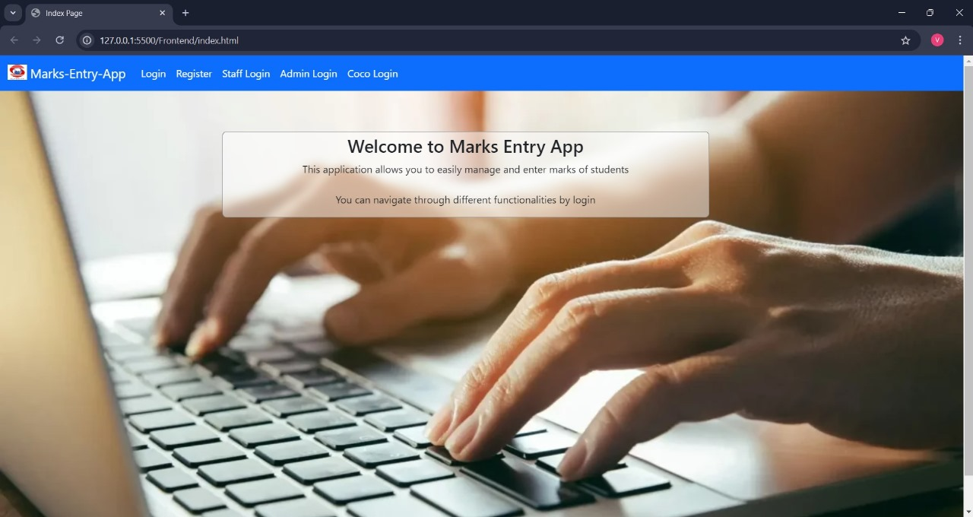

Slide 10
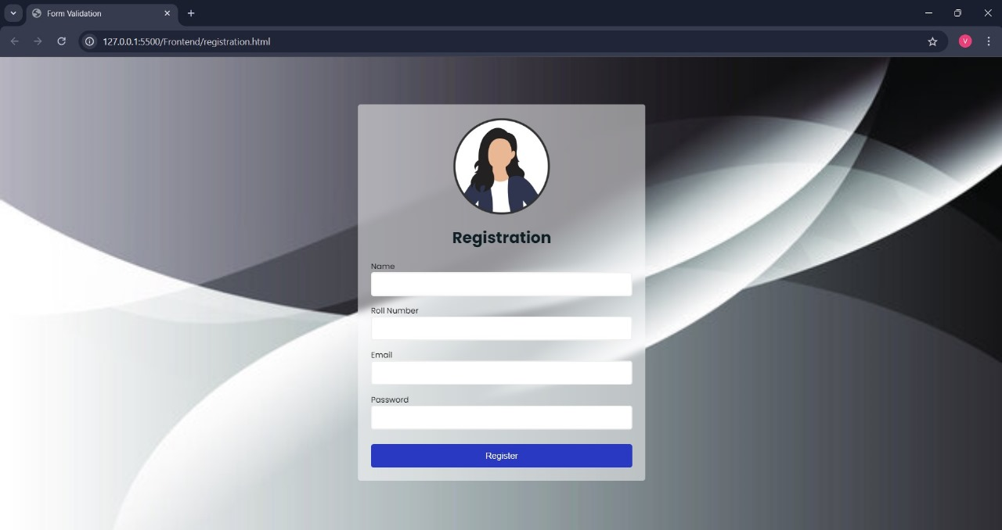
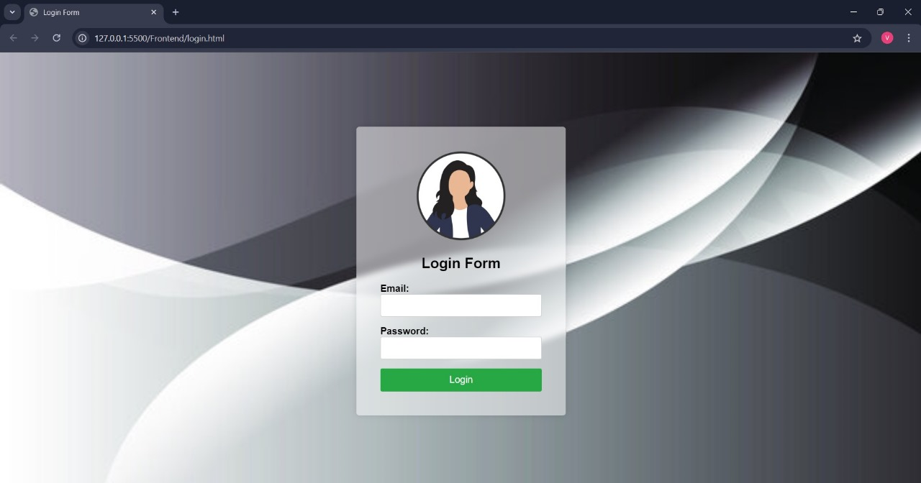
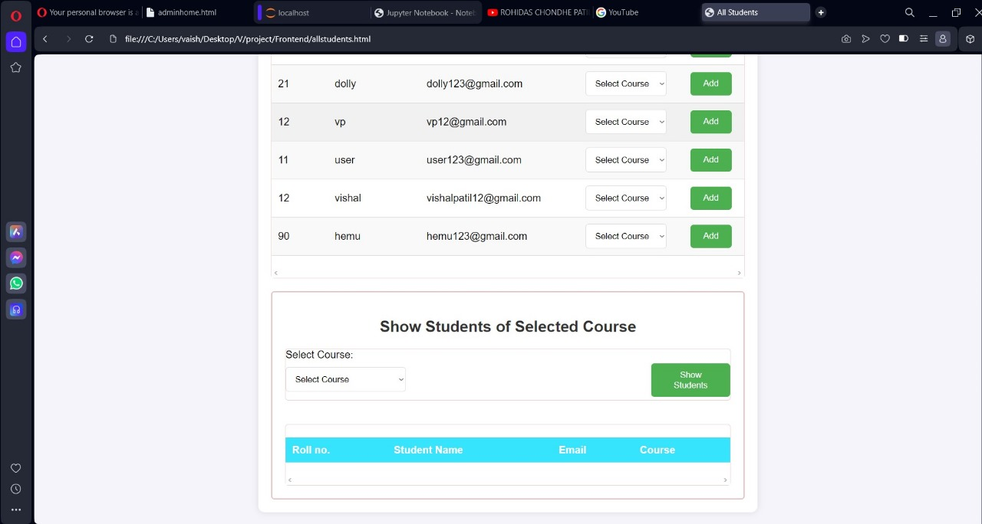
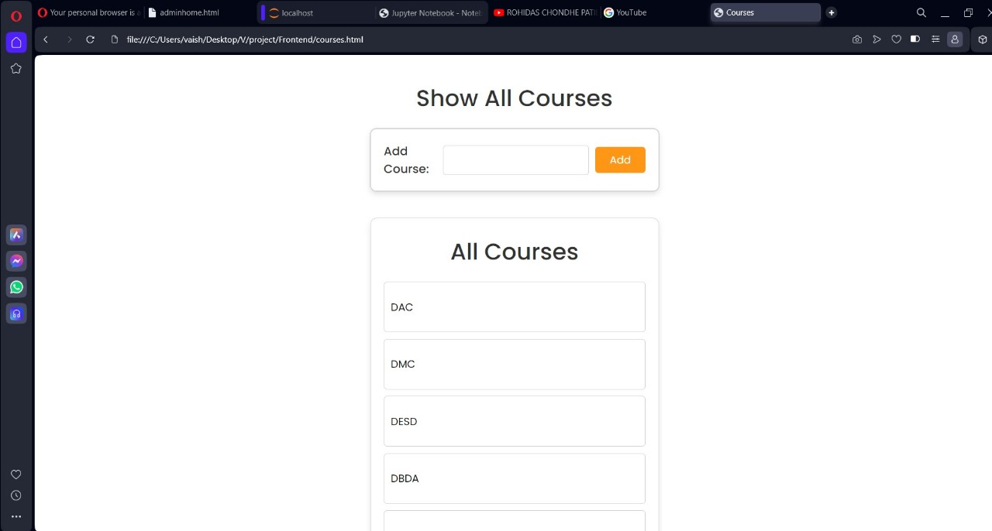

Slide 11
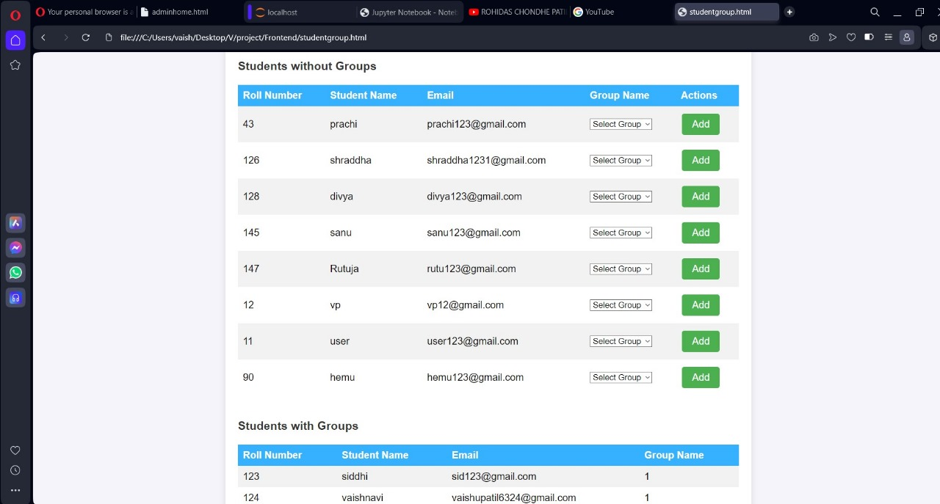
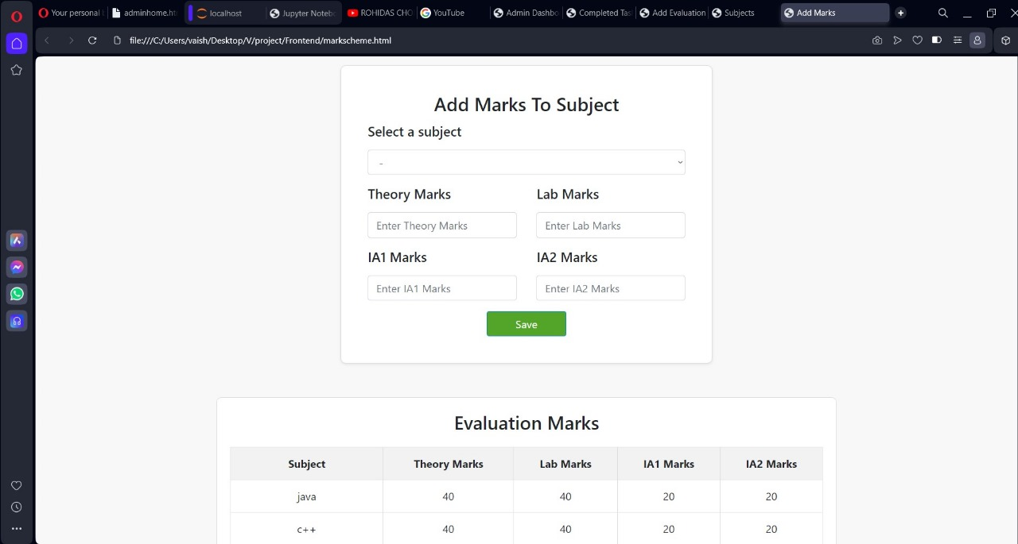

Slide 12
